Slide 1
Data Science Nano Degree Project
Write A Data Science Blog Post
Submitted by: Rachna Sapra
Official email id rachna.sapra@Natwest.com
Personal email id: rachnasapra5@gmail.com

Slide 2

Business context- Airbnb Analysis (Seattle Vs Boston)
About Airbnb: It’s an American vacation rental online marketplace company based in San Francisco, California, United States. Airbnb maintains and hosts a marketplace, accessible to consumers on its website. or via an app.
Seattle is quite new than Boston
Boston is more expensive the Seattle which will further help to answer my questions.
Deep dive into there business will be answerable by our Analysis and questions we are answer.

Slide 3
About Data (Seattle Vs Boston)
Seattle | Boston | Is feasible for comparison?
Listing | Listing | Yes ( As variable are similar)
Calendar | Calendar | No(Data in both csv are on different calendar dates, so exact pattern can’t be driven
Reviews | Reviews | No(Because of time issue)
I have used Listing dataset for Seattle and Boston from https://www.kaggle.com which I pick from project Page. I used various Python libraries that are listed below:
1. Numpy
2. Pandas
3. Sklearn
4. Seaborn
5. matplotlib.pyplot
6. Collections
7. Math

Slide 4
3 Questions choose to answer but both will be answer from both dataset Seattle Vs Boston
What are the most common amenities? Also which most liked and unliked one-There are some things found during Analysis like most popular amnesties and least popular amenities ?
What attracts the guests most for renting a property in 30, 60, 90 booking days buckets?
What are the most influential features of the dataset to estimate the price of a listing?

Slide 5
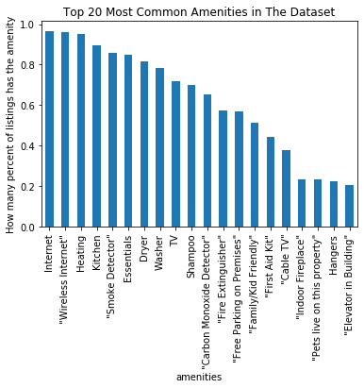
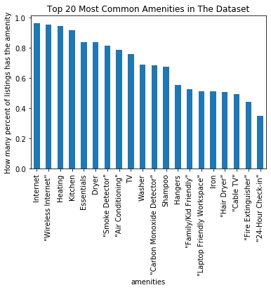
What are the most common amenities? (Seattle Vs Boston)
Seattle Amenities
Boston Amenities
In both cities: 1.Internet 2.Wireless Internet 3.Heating 4.Kitchen
5.Essentials are top most amenities used.

Slide 6
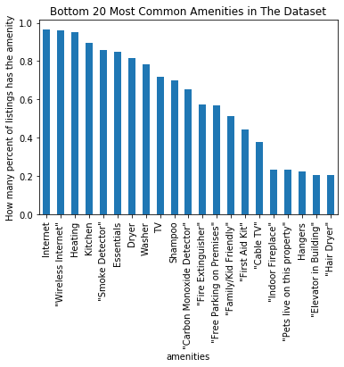
In Seattle Top/Bottom Amenities

Slide 7
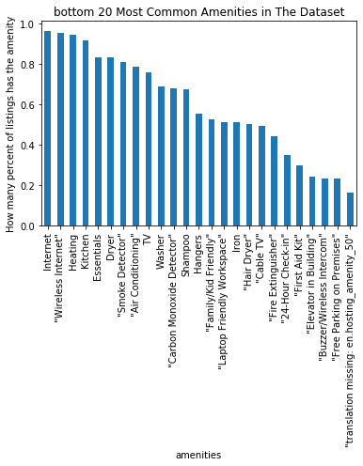
In Boston Top/Bottom Amenities

Slide 8
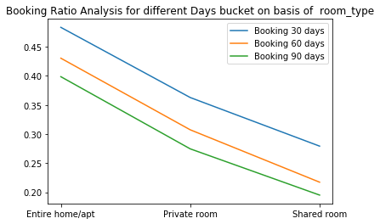
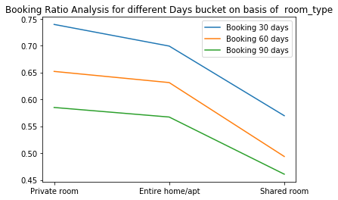
What attracts the guests most for renting a property? Here I used 30, 60, 90 days split to understand the property type as well as days segment split which is more convenient.
Seattle Amenities
Boston Amenities
Conclusions:
1. We can see in Seattle Entire Room is more popular whereas in Boston private room.
2. When we see 30, 60, 90 which days spend is more popular line graph clearly tells the trend that Booking 30 days is most popular.

Slide 9
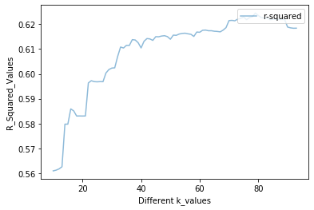
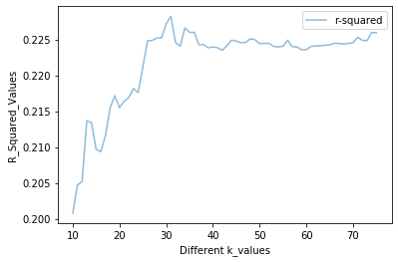
What are the most influential features of the dataset to estimate the price of a listing?
This is better answered in Python Notebook but seattle has far better result that Boston as R-square value for Seattle was btter that Boston.
Although features were 79 approx. for Seattle where for Boston is 31 far less.

